Slide 1
Mass Effect:
A Trilogy
Video Games
By
Brandon Bandy

Slide 2
Agenda
01
Why I chose Video Games
Slide 03
02
Mass effect’s selection
Slide 04
03
Relevant quest of Mass Effect
Slide 06
04
Relevant quest of Mass Effect 2
Slide 08
05
Relevant quest of Mass Effect 3
Slide 10
Confidential

Slide 3
Why Video Games?
I had chosen the topic of Video Games for a very simple reason.
I had no idea what else to choose and just decided to focus on a passion of mine
Even though it doesn’t really fit with the topic of the class in general besides the fact that video games are a form of technology based entertainment.
So, I chose the topic itself in a pretty random way, right?
Well i had chosen the subtopics with a much more specific reason.
A Trilogy of games all of which have various examples of Technology battling against the forces of the Organic Civilization.
Now that is more fitting for a class about Computers

Slide 4
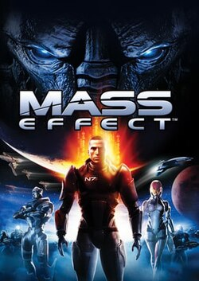
What is Mass effect?
Made by Bioware in 2007
Mass effect is a space age RPG title that is focused on Commander Shepard and a crew of aliens and humans taking on a rogue cosmic Criminal named Saren in hopes of preventing him from bringing death and synthetic doom down onto the Galaxy.
Image Taken from Wikipedia’s entry on Mass Effect

Slide 5
Why Mass effect?
Old Childhood Favorite
It’s plot is perfect for a class on computers
The overarching themes of the Trilogy of Mass effect games boils down to an idea of advanced technology’s part to play in the destruction of organic civilizations.
While it is a lot more extreme in the games we have had similar fears and questions about AI and its huge presence in our lives
I loved this game as a child.
This series became one that facilitated my love for all things Sci-Fi and space themed.
Confidential

Slide 6
This is a early game quest for the first game in the trilogy.
You and your crew are tasked with finding the source of a malfunctioning Gambling Machine in the Citadel’s casino Flux.
Eventually you are able to locate the destination of all these stolen funds.
Turns out that there is an AI behind it all trying to escape the Citadel knowing they would purge its data if it was found to be a sentient thinking AI.
Mass Effect 1:
Citadel: Signal Tracking
Confidential

Slide 7
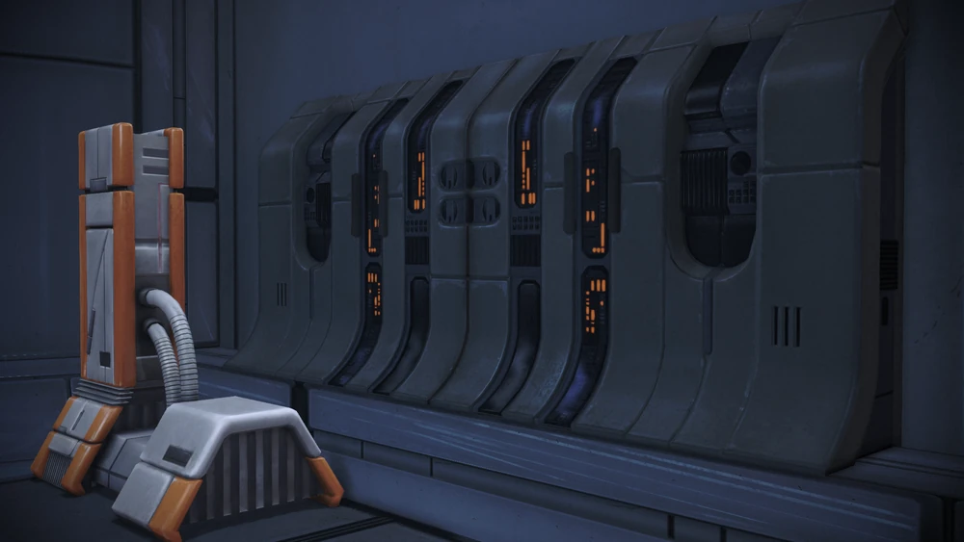
The AI terminal from the Quest
Image gained from Mass Effect Fan Wiki:
https://masseffect.fandom.com/wiki/Citadel:_Signal_Tracking?file=Quasar_AI.png

Slide 8
The second Mass Effect has a whole DLC that is focused on the Idea of ‘The dangers of AI’ or it at least seems to at first.
The DLC Overlord has the player along with their crew finding a derelict Research station that seems to only have a single survivor.
That Survivor claims to be a scientist and that a rogue AI had taken over the Station in hopes of killing them all.
In reality the ‘AI’ was the remaining scientist’s brother who they had tortured in hopes of using his abnormal mind to better harness and control machines.
Mass Effect 2:
Overlord
Confidential

Slide 9
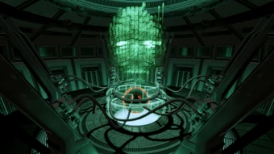
Overlord’s ‘AI’
Image taken from Mass effect Wiki:
https://masseffect.fandom.com/wiki/Overlord:_Atlas_Station

Slide 10
Mass Effect 3 is a lot more focused on the issues of cycles of technology eventually consuming or destroying their creators
So instead of a side quest or larger DLC I am going to focus on the ending of the game.
The Ending has the player speaking to an AI that had been created by an ancient race of aliens to prevent their empire from falling.
This AI Eventually determined that the biggest threat to organics was the Technology they created and began to cull any galactic civilization that reached a technological point similar to their creators and destroy them to keep the backwards ‘cycle’ going.
Mass Effect 3:
Ending
Confidential

Slide 11
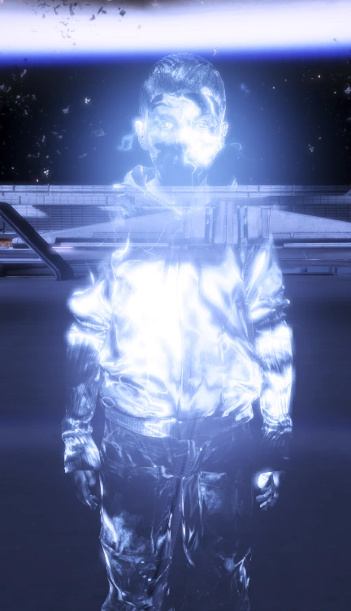
Physical Representation of the ‘Star Child’ AI from Mass Effect 3
Image taken from: https://inconsistently-heinous.fandom.com/wiki/The_Catalyst

Slide 12
Thank you!
Confidential

